Slide 1
Intro to Neural Nets
RNNs for Text

Slide 2

Today’s Agenda
Background on NLP
Use Cases
Quick review on bag of words approaches, etc.
TextVectorization Layer
This implements basic standardization and punctuation removal. It assumes 1-grams, then one-hot encodes.
No stemming or stop word removal, by default.
Sequence vs. Bag-of-Words
Conceptually
Architectures for Sequences
Bidirectional LSTM

Slide 3
Quick Review of NLP Concepts
Pre-processing Text
Lower-casing, stop word removal, stemming, removing punctuation, stripping rare tokens, etc.
Tokenization (this may be chars, words, sentences, etc.
Integer encoding / indexing the tokens.
Finally, I may or may not leverage sequence information.
Q: what is a bag of words approach? What are n-grams?
 | Database | SQL | Index | Regression | Likelihood | linear
D1 | 24 | 21 | 9 | 0 | 0 | 3
D2 | 32 | 10 | 5 | 0 | 3 | 0
D3 | 12 | 16 | 5 | 0 | 0 | 0
D4 | 6 | 7 | 2 | 0 | 0 | 0
D5 | 43 | 31 | 20 | 0 | 3 | 0
D6 | 2 | 0 | 0 | 18 | 7 | 6
D7 | 0 | 0 | 1 | 32 | 12 | 0
D8 | 3 | 0 | 0 | 22 | 4 | 4
D9 | 1 | 0 | 0 | 34 | 27 | 25

Slide 4
Weighting Term-Documents: TF-IDF
Not all phrases are of equal importance…
E.g., David less important than Beckham
If a term occurs all the time, observing its presence is less informative
Inverse-document frequency (IDF) helps address this.
Term ‘weighting’ is then calculated as Term Frequency (TF) x IDF
n_{j}= # of docs containing the term, N = total # of docs
A term is deemed important if it has a high TF and/or a high IDF.
As TF goes up, the word is more common generally. As IDF goes up, it means very few documents contain this term.

Slide 5
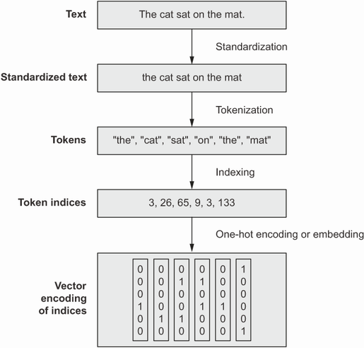
TextVectorization Layer
Pre-processing Text
Standardization, tokenization (words), one-hot-encoding / vectorization.
The Keras TextVectorization() layer achieves these steps quickly.
Customization
You can work with n-grams, and do other sorts of pre-processing, using arguments.
Options
Include as part of TF Dataset pipeline (more efficient)
Include as a layer in your Keras model.
Notes:
All text vectorization techniques generally work the same way.
We throw out words we don’t want, standardize the rest.
We then tokenize the text (split into lists of characters, words, or word-groups.
We then convert each token into some numeric vector representation (many ways we might do this).

Slide 6
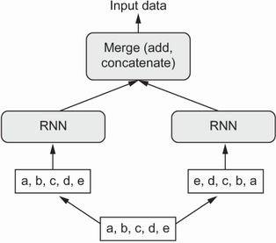
Bidirectional LSTM
We Saw This Last Time
Take each sequence as input data, as well as a flipped/reversed copy.
Was state of the art for text processing until relatively recently (transformers now dominate).
Instead of Time Series We Pass…
Sequences of one-hot-encodings of terms.
Sequences of pre-trained vector embeddings of terms.

Slide 7
Masking
RNNs with Ragged Lists
Lists where each element is a sequence of variable length *can* be handled here, but not automatically.
A batch in Keras must be of a fixed dimensionality; we use padding and truncation to achieve this.
We Deal with Variable Lengths Using a Mask
The Masking layer “flags” sequence elements that are to be ignored by subsequent layers (e.g., an LSTM) that have the ability to process a mask.
The output of masking layer passes on the input + a second tensor of the same shape, containing Boolean values (True = process, False = ignore).
By default values of 0 get ignored, but we can override this.

Slide 8
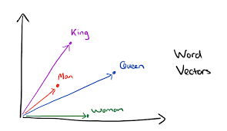
Embedding Layer
With Hot Encodings, Model Will Still Struggle to Figure Out Semantics
Despite having sequence, the model is “told” that the tokens are orthogonal / independent of one another in their meanings. But that’s not true!
Textual Embedding Layer First Provides Dimensionality Reduction
Represent words into a lower dimensional space – similar vector = similar meaning.
The Embedding layer is a lookup table that maps tokens to vectors. For each token in the vocabulary, the network learns a vector representation. The vectors are initially random, and the network updates them in training to learn representations that help in prediction (just like with convolution filters!).
In practice, it is learning semantic relationships…
This is much better for an RNN than a hot encoding, because 120 values (for example) is << 20,000!
Notes:
Available pre-trained embedding layers (e.g., trained on Wikipedia page data), but you can also fit these models on your own corpus of text, to learn context-specific embeddings.

Slide 9
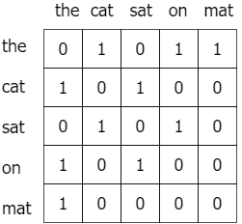
Pre-Trained Embeddings: GloVe
Global Vector Representation
Based on a giant term-term co-occurrence matrix – rows are vectors of co-occurrence (conditional) probabilities.
Two terms are similar if their ratios of co-occurrences with other terms are about equal.
Roughly speaking, GloVe learns word vectors, e.g., v_i and v_j, such that the dot product of any pair of vectors is equal to their co-occurrence ratio P(v_j | v_i).
This is achieved via a gradient-descent optimization.
Notes:
Available pre-trained embedding layers (e.g., trained on Wikipedia page data), but you can also fit these models on your own corpus of text, to learn context-specific embeddings.

Slide 10
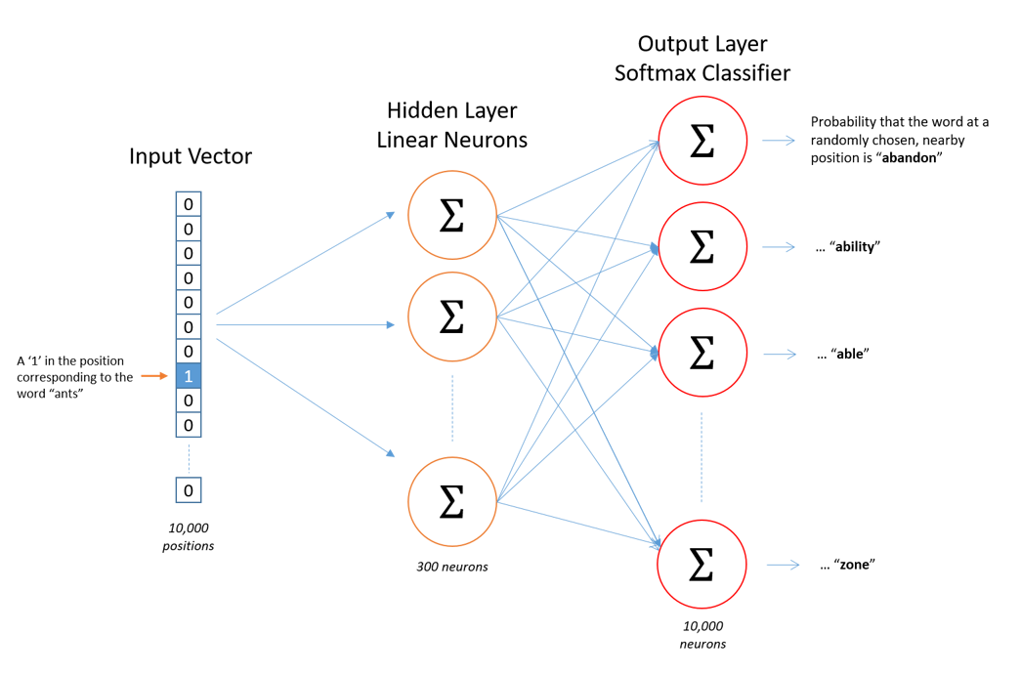
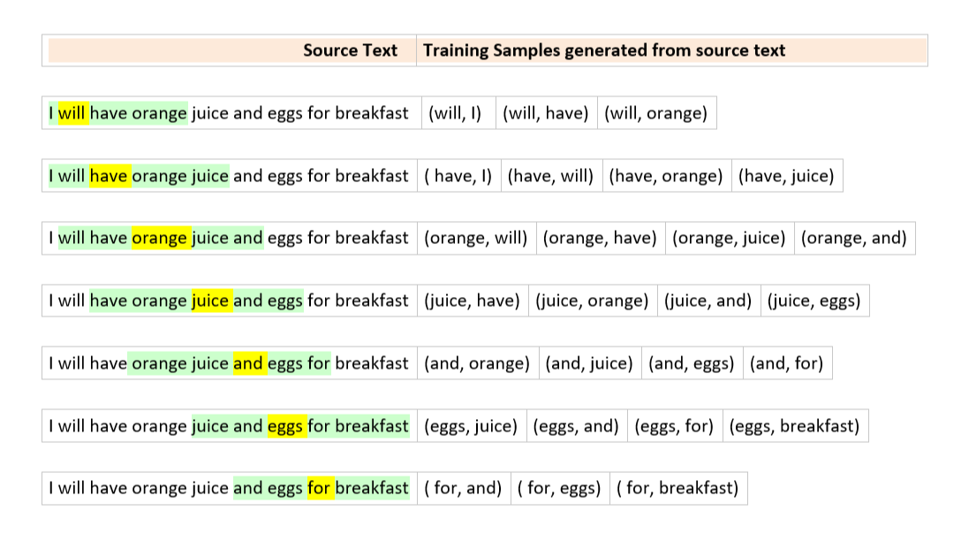
Pre-Trained Embeddings: Word2Vec
Word2Vec
Two types: CBoW and Skipgram
Construct training examples and labels.
Notes:
This is skipgram on the right. One word to surrounding context words (we map input word to

Slide 11
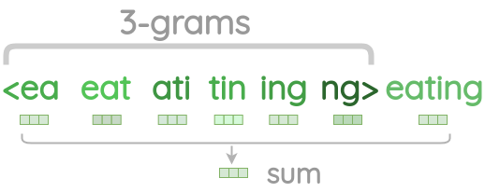
Pre-Trained Embeddings: Limitation
Out of Sample Words
Both GloVe and Word2Vec are limited to words you’ve seen before in training. They cannot handle new words. Those words thus get omitted / dropped, or you need to do something different.
FastText
An extension to Word2Vec which learns character n-grams of words. So, instead of embedding words, we embed portions of words (e.g., a 3-gram character representation would break up the word ‘coffee’ into ‘cof’, ‘off’, ‘ffe’, … and then learn vector embeddings of each.
Notes:
This is skipgram on the right. One word to surrounding context words (we map input word to

Slide 12
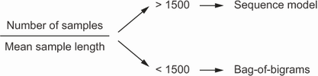
Sequence vs. Bag-of-Words
Word-Ordering Contains Information
We can get a weak representation of language sequences using n-grams, but this can be limited.
Sequence-models may provide leverage more information from language in prediction tasks (if we have enough examples, and the sequences are short enough).
We can represent these sequences with RNNs, typically bidirectional RNNs (because word ordering and interpretation is not always linear).

Slide 13
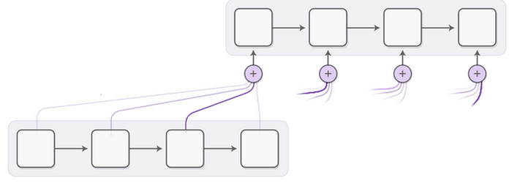
General Attention
Provide the Network with a Way to Learn Where it Should Focus
Rather than having the network assume equal relevance across all inputs it encounters, we can let it learn to focus on different segments of the input.
These ideas apply to inputs that have any sort of structural relation between elements
In the case of CNNs, we might let our network learn to focus its attention on certain segments of a photo based on the features / values it encounters in said segments.
In the case of RNNs, we might let our network learn to focus its attention on certain tokens in a string base (e.g., important words or sounds).
Notes:
Attention layers are a very general concept. They are also implemented in many ways, using custom layers in Keras, for example, or using pre-defined layers. The book gives one example of an attention mechanism, Self-Attention, which is based on vector dot products between words’ vector embeddings. Just understand that this is merely one example of attention, and it’s not how every attention layer works.
Matrix on the left is the result of taking dot products between word (e.g., on the row index, station) and every other word (column index) (this is imaginary). We then take the resulting values and scale them / run them through a softmax. This will yield values 0-1, that sum to 1. Last step is to multiply those scores by all the associated term vectors in the sequence, and then add them together. The result is a new ‘shifted’ word vector for ‘train’, which is ‘context aware’ (of other items in the sequence with it).
Remember, vector dot product is project of A onto B. So, if two words are orthogonal in embedding space (they are completely unrelated) then the dot product with be 0. If two words are parallel, it means they are semantically related, and their dot product will approach 1.

Slide 14
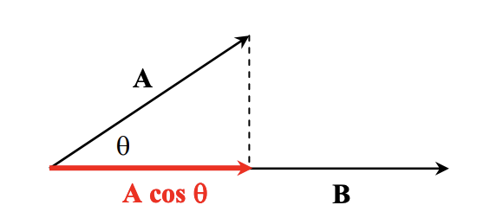
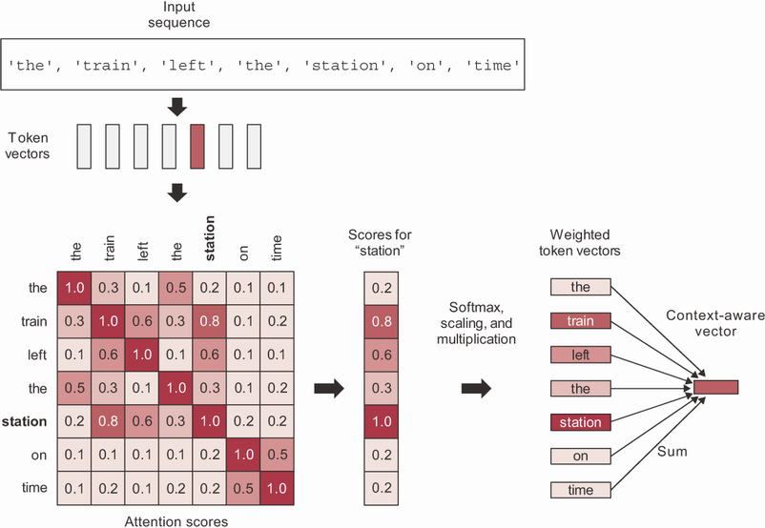
Self-Attention
We Can Also Enable Broader Contextual Consideration
Self-attention allows the network to evaluate the importance of an input element (e.g., token) based on that that element’s value and all the other element values.
Basically, it gives the network a way to shift focus to certain items that are useful, considering informational connections that may be very distant in the input sequence or image.
Notes:
Attention layers are a very general concept. They can be implemented in many ways, using custom layers in Keras, for example, or using pre-defined layers. The book gives one example of a self-attention mechanism in text, which is based on vector dot products between words’ vector embeddings. Just understand that this is merely one example of attention, and it’s not how every attention mechanism will work.
Matrix on the left is the result of taking dot products between word (e.g., on the row index, station) and every other word (column index) (this is imaginary). We then take the resulting values and scale them / run them through a softmax. This will yield values 0-1, that sum to 1. Last step is to multiply those scores by all the associated term vectors in the sequence, and then add them together. The result is a new ‘shifted’ word vector for ‘train’, which is ‘context aware’ (of other items in the sequence with it).
Remember, vector dot product is project of A onto B. So, if two words are orthogonal in embedding space (they are completely unrelated) then the dot product with be 0. If two words are parallel, it means they are semantically related, and their dot product will approach 1.

Slide 15
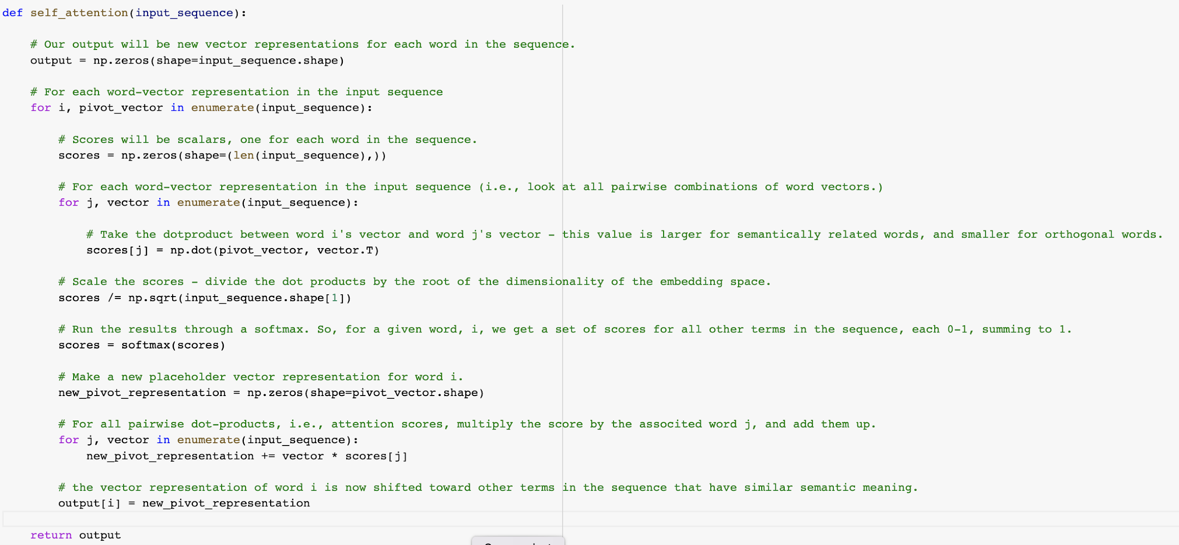
Self-Attention Layer

Slide 16
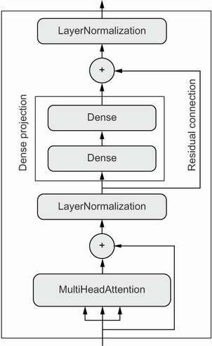
Transformer Architecture
Implement Multiple, Parallel Attention Mechanisms
This allows the model to figure out different ‘types’ of attention patterns.
So, maybe the model should pay attention to word 1 and word 4 for one ‘reason’ and it should pay attention to word 3 and word 8 too, for a different ‘reason’.
Transformer Builds on Multi-Head Attention
It stacks the parallel attention layers with normalization layers and dense layers, plus some residual connections to enable better gradient updates.
LayerNormalization() normalizes within sequence, instead of across the batch.
Notes:
I’ll come back to this next class!

Slide 17
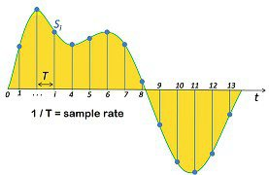
RNN for Audio
Same Sequence Concepts Work for Audio Data
Audio files are just sequences of numeric values (amplitude), possibly two if it was recorded in stereo.
Once we recognize this, we realize we can predict things about audio sequences too!
Notes:
This is skipgram on the right. One word to surrounding context words (we map input word to

Slide 18
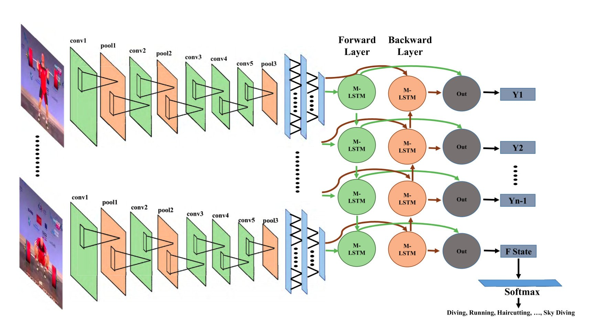
CNN-RNN for Video
Hybrid Topology for Image Sequences
We Use CNN’s to detect features at a given input.
We feed those feature maps into an RNN architecture, like LSTM.
We can use this topology to predict things about videos.
You might pre-process frames using a pre-trained CNN and pass feature maps as sequences to an RNN.
Notes:
This is skipgram on the right. One word to surrounding context words (we map input word to

Slide 19
Questions?
Notes:
Weights are not initialized until you “build” the model (or compile it, which will first build).

